Slide 1
Wilms tumor
Case Presentation
Dr Shweta Bansal
Ped Hemonc and BMT
Sir HN Relaince Foundation Hospital , Mumbai

Slide 2
Tumor Board complex Wilms case Discussions
Main Points
Purpose : To engage in collaborative review of complex cases
Objective : Identify practical challenges, therapeutic decisions and potential improvements
Outcome : Share collective expertise to enhance patient care strategies and outcomes

Slide 3
Case History and Presentation
Case 1
Case 2
History :
Age 1.2 years
Gender: boy
CC: Presenting with complaints of decrease feeding and lethargy and gradually increasing abdominal distension
The size of the abdomen was gradually increasing more on the right side
History :
Age : 1. 9 years
Gender : Girl
CC : Child brought by parents to ER with c/o- Fever since 21 days (Tmax- 103F) 3 spikes/day not a/w chills. T/t with Syp Crocin DS .
H/O mucus in stool. Passing hard stool since 2 days
Pediatrician On examination noticed lump in the abdomen

Slide 4
Case History and Presentation
Case 1
Case 2
Family History : Grandfather had throat cancer
Developmental history : normal
Vaccination history : immunized for age
Neonatal period : unremarkable
Family History : No history of cancer
Developmental history : normal
Vaccination history : immunized for age
Neonatal period : unremarkable

Slide 5
Case Clinical Presentation
Case 1
Case 2
Normal growth
No syndromic features
No hypertrophy of any limb
BP -84/61 , RR 28 , HR 110b/min
Per abdomen – abdomen distended
Mass palpable on the right iliac fossa , firm to hard
Normal growth
No syndromic features
No hypertrophy of any limb
BP -95/58 , RR 32 , HR 130b/min
Per abdomen – abdomen distended
Mass palpable on the left iliac fossa , firm to hard

Slide 6
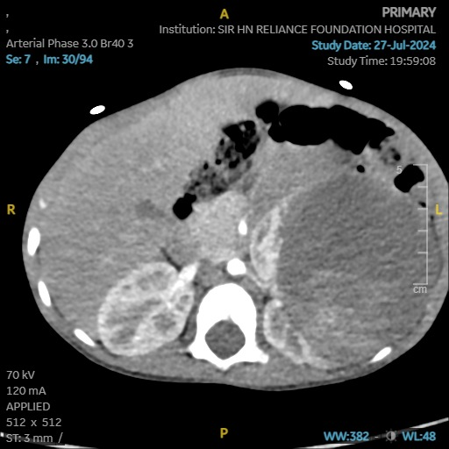
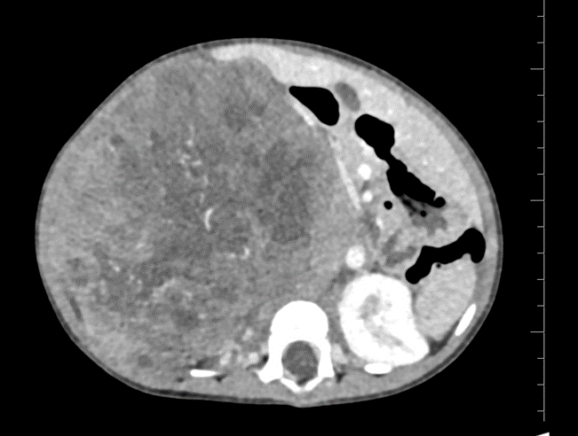
Imaging
Case 1
Case 2
A large well defined heterogeneous mass lesion measuring 12.3 x 11.2 x 12.9 cm from the mid and lower pole of right kidney with a large exophytic component. Multiple hypodense area seen within likely necrosis. Right adrenal gland is not visualized separately from the lesion. Mass likely to be Wilms tumor or neuroblastoma
A large well-circumscribed lesion with mixed solid cystic areas and few areas of calcification is noted arising from the left kidney displacing the remnant renal parenchyma and renal pelvicalyceal system medially measuring 7.4[W] x 7.4[AP] x 8.3[H]cm. The lesion is predominantly cystic with enhnacing solid component and septations. No extension or thrombosis of the renal vein or IVC.

Slide 7
Next Step
Surgery or biopsy

Slide 8
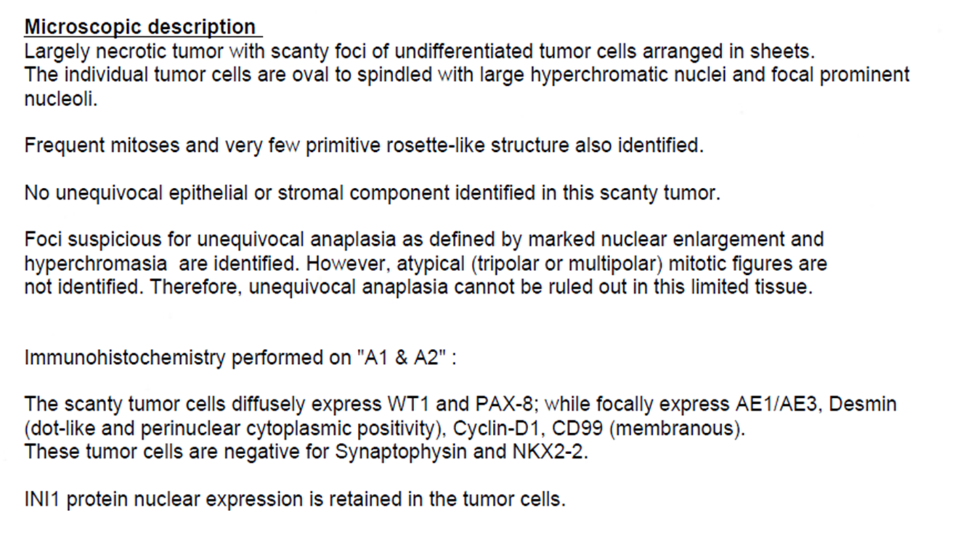
Biopsy
Case 1
Case 2
Sections show renal parenchyma consisting of fibrocollagenous tissue and an occasional glomerulus and tubule along with tumor tissue.
Tumor composed of round to oval malignant cells with hyperchromatic nuclei, arranged in sheets and nodules. Mitotic figures present.
An occasional rosette seen. A focus of stroma with malignant cells seen. Tubules not appreciated in tumor tissue.
Necrosis not appreciated. Features of malignant small round cell tumor.

Slide 9
Biopsy
Case 1
Case 2
Impression : Wilms Tumors
with triphasic element
with predominant blastemal component
No anaplasia
Impression : Scanty undifferentiated tumor
Consistent with monophasic nephroblastoma
With anaplasia
With blastemal component

Slide 10
Further Management
Two drug or three drug regimen pre surgery

Slide 11
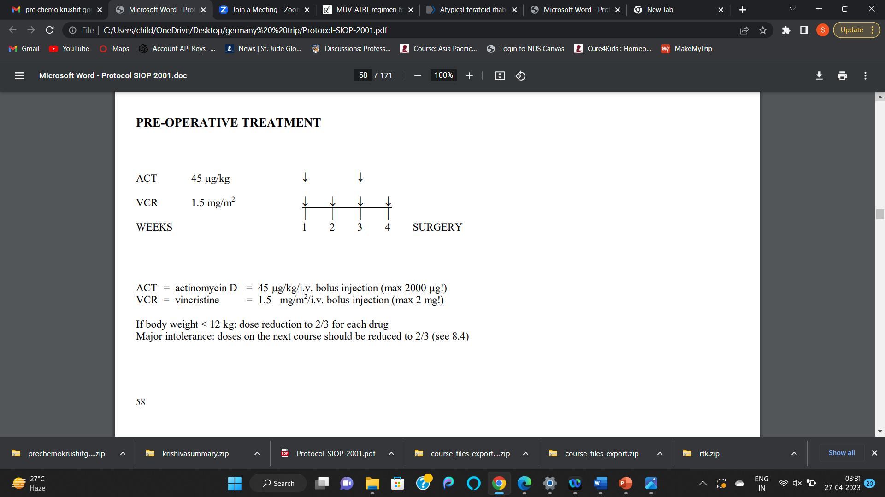
Treatment plan

Slide 12
Surgical notes
Case 1
Case 2
Right upper transverse incision placed that extended upto Left MCL.
Abdomen explored, Right renal mass separated from caecum and asending colon by dissection using cautery.
A large Right renal mass seen (15 X 12 cm size) adhered medially to duodenum and superiorly to under surface of liver.
Dissection done using ligasure and renal vessels secured.
Small branches and tributaries cauterized.
Mass was separated from under surface of liver using cautery and Infrahepatic IVC exposed.
Dissection along inferior surface done to expose right ureter.
Right ureter cut after placing the clips.
Right renal vein and artery identified and divided.
Careful Medial dissection done to separated IVC from the mass.
LN sampling done including: Infrahilar paracaval, Hilar paracaval, Suprahilar paracaval, Infrahilar intra-aortocaval, Suprahilar intra-aortocaval, Abdomen closure done in layers.
Left supraumbilical transverse incision crossing midline –Large (approximately 8.5cm x 8.5cm x 7.5 cm)firm mass noted in left kidney
3 x left renal arteries doubly ligated and cut , ligaclips applied on all arteries
Left renal vein doubly ligated and cut after saving gonadal and left adrenal veins
Left adrenal gland dissected free from renal mass and normal upper pole of left kidney
Left ureter ligated and cut at pelvic brim
Radical left nephrectomy done keeping gerota's fascia intact
Specimen delivered in formalin jar - sent for HPE
Multiple lymph nodes dissected and sent for HPE
Left paraaortic infra renal Left paraaortic renal - hilar level, Left paraaortic supra renal, Right paraaortic infra renal , Right paraaortic renal - hilar level lymph node, Right paraaortic supra renal lymph nodes

Slide 13
Histopathology
Case 1
Case 2
GROSS EXAMINATION : Recieved right neprectomy specimen measuring 11cm x 8 cm x 5 cm including perinephric fat. External surface is boselated. Ureter seen measuring 4 cm, along with cut end of artery and vein.
The capsule is adherent to the kidney at few places.
Gross examination : Radical nephrectomy Specimen
Serial cut shows circumscribed encapsulated tumor 8.5 x 8.6 x 6.5 cm with extensive areas of necrosis
Perirenal fat and gerota`s fascia uninvolved
Pelvicalyceal system and renal sinus is univolved on gross description

Slide 14
Histopathology
Case 2
Case 1
Viable tumor is more than 1/3 rd of the entire mass. The blastamel component is more than 2/3 of the entire tumor.
The cut margin of ureter, vein and artery at the hilum is free of tumour.
The connective tissue at the hilum consists of tumor deposits.
Tumor deposit seen in the perirenal fat, capsule and Gerota's fascia.
No evidence of anaplasia.
Infrahilar paracaval lymphnode --. Tumor deposits seen along the peri nodal connective tissue.
Viable tumor 55%, with blastemal component (27%), epithelial componenet (9%) , mesenchymal component (19%)
Mesenchymal component shows rhabdomyoblastic component
The ureter, vein and artery at the hilum is free of tumour.
perirenal fat, capsule and Gerota's fascia are free of tumor
Renal Sinus involved by tumor
Diffuse anaplasia present
All Lymph nodes negative

Slide 15
Final staging and risk stratification
Case 1
Case 2
Local staging- Stage 2 ( Perirenal fat involvement
Upgraded to stage III – for perinodal connective tissue involvement
Risk – 2/3rd blastemal component
Local staging – Stage 2 ( renal sinus involvement )
Risk – Diffuse anaplasia

Slide 16
Tumor Board Discussion
Is biopsy justified in both cases or surgery could have done upfront
Or we can start chemo without biopsy in these cases
And role of two versus three drug chemo considering high risk features in biopsy report
Any comments on surgery reporting or histopath reporting
Any role of local radiation, if yes what the best time and dose of radiation
Any role of high risk chemotherapy

